Slide 1
Computer Science
ENGL 109W Project #2
Matthew Mendoza

Slide 2
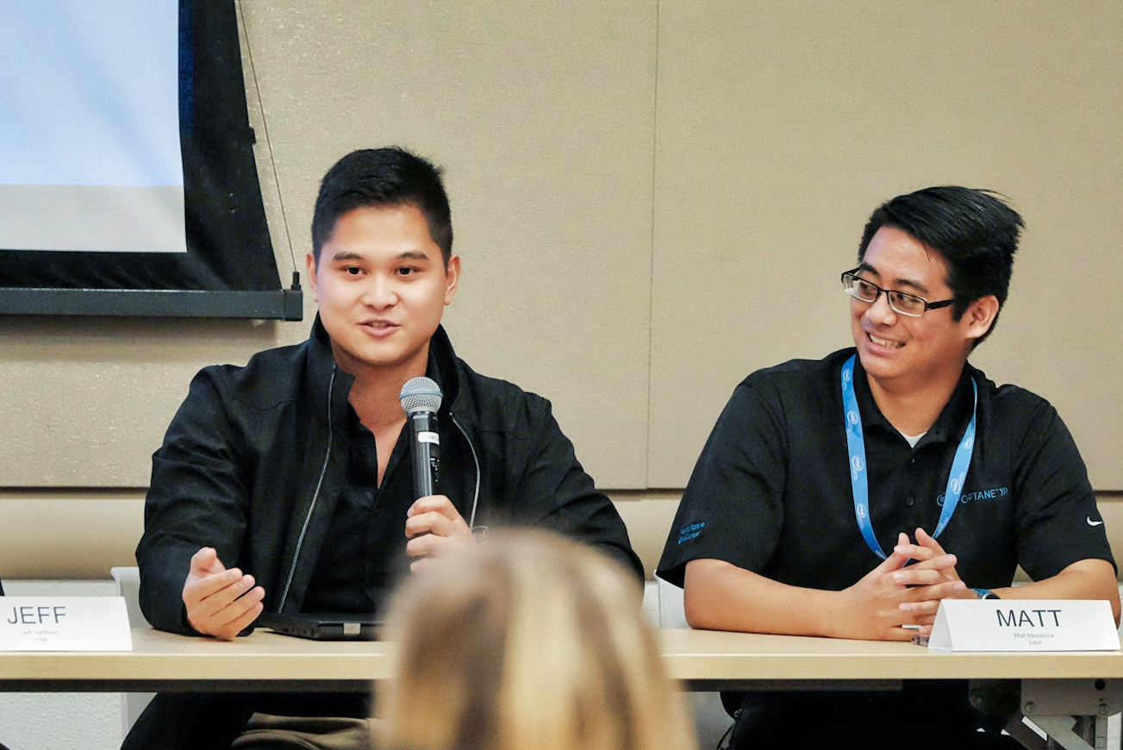
WHY I CHOSE COMPUTER SCIENCE
I love tinkering with things and learning new concepts or develop new insight.
From changing out the batteries of the TV remote early on and to building computers for fun
Computer Science, especially code, allows me to tinker with anything that has the capacity to compute (take input, process, and produce an output)

Slide 3
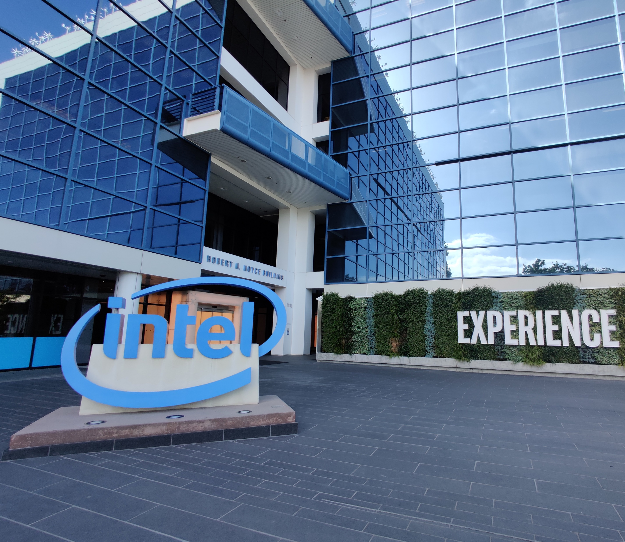
Original Thoughts
Computer Science is not all about coding, it’s a means to an end, but is the focus and study of computation (inputs, processing, and outputs)
Computer Science students are taught and encouraged to practice methodical, structured, thinking by way of Stepwise Refrainment: taking a task and break it down into smaller, trivial, subtasks.
Many computer science students may feel that schools fail them in teaching the latest technologies, but in a fast-moving industry schools can’t teach the state-of-the-art for most times they are unproven, are often proprietary, and/or lack of individuals how can teach the topic.
As a result, schools teaches the fundamentals most technologies are built from

Slide 4
Research Questions
What do non-computer science students need to know about the computer science discourse community?

Slide 5

Interview
The interviewee: Tyler Smart
10+ years of experience
Holds a Doctorate in Physics
Professional Software Developer
Interview held in-person
Highlight: a wonderful coworker and mentor
Documents
Java Project for CSC 133
Technical Document: Open Compute Project Foundation (OCP)

Slide 6
Interview Questions
What types of reading/writing/research do students need to do in Computer Science for academic assignments?
What special form/format/style/vocabulary should I use? Why?
What types of writing do professionals often do on the job in computer science?
How do professionals communicate most often with each other in computer science?
How do professionals communicate most often with clients in computer science?
How do professionals in computer science research important information needed for the job?
What types of documents or publications do professionals in computer science read on the job? Why?
What is the most important type of document professionals in computer science need to know how to write/produce?

Slide 7
Interview Response
What types of reading/writing/research do students need to do in Computer Science for academic assignments?
Unless you’re going into graduate school with a particular focus in a field of Computer Science there isn’t much “research” to have. The industry moves fast and depending on where you want to take your career it’s hard to say any specific types of reading, writing, and/or research one would need to do. However, our field requires one to be a life-long-learner those with a growth mindset will often find themselves in more fruitful opportunities than those who are of the fixed mindset and stop learning.
What special form/format/style/vocabulary should I use? Why?
When writing code, you are in the confined within the given programming languages syntax and structure; however, when writing code, you should not make it as if it was “code” write your program to be human readable written like good pros where your variables and classes are nouns and your functions read as verbs that operate on said variables.
What types of writing do professionals often do on the job in computer science?
Computer science encompasses a lot of fields so it’s hard to say. For what you [referring to me] and I [Tyler Smart] the type of writing we do is mostly code and documentation of the code.
How do professionals communicate most often with each other in computer science?
We are all introverts Matt… Prior to Covid we’d attend tech conferences or attend conventions.

Slide 8
Interview Response Continued
How do professionals communicate most often with clients in computer science?
If your team follows Agile methodologies, it should be the Product Owner’s role to be the bridge, the point of contact, between technical staff and the customer.
How do professionals in computer science research important information needed for the job?
Is often Googled on the spot or in a Stack Overflow post.
What types of documents or publications do professionals in computer science read on the job? Why?
Read what interest you and read beyond technical items. Computer science, especially programmers, are solution solvers given any problem. You are paid to make solutions and apply a system to a problem. So if your interested in Football read as much as you can, so when the opportunity arise to start development on the new NFL game you have both the technical software and game rules under your belt to your benefit.
What is the most important type of document professionals in computer science need to know how to write/produce?
The most important type of document you need to know how to write is your own code. Although it is targeted for a computer higher level languages, like C++ and Java, should be written in a manner where new to the project on first glass be able to understand what your code does without reading “code”.

Slide 9
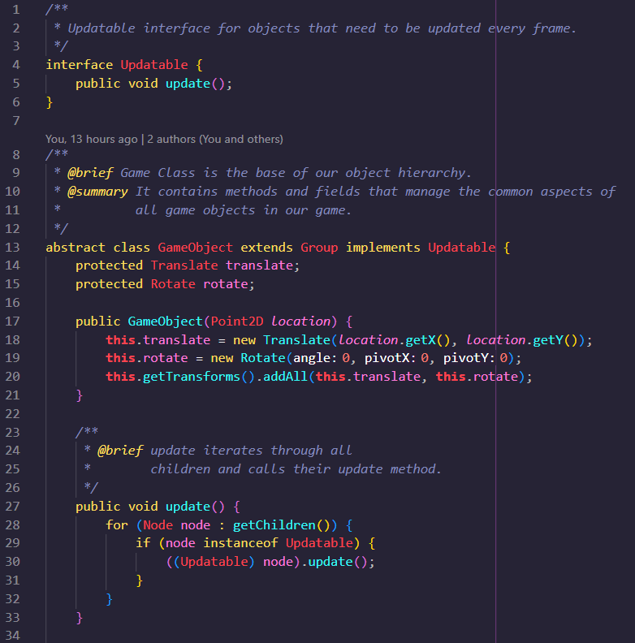
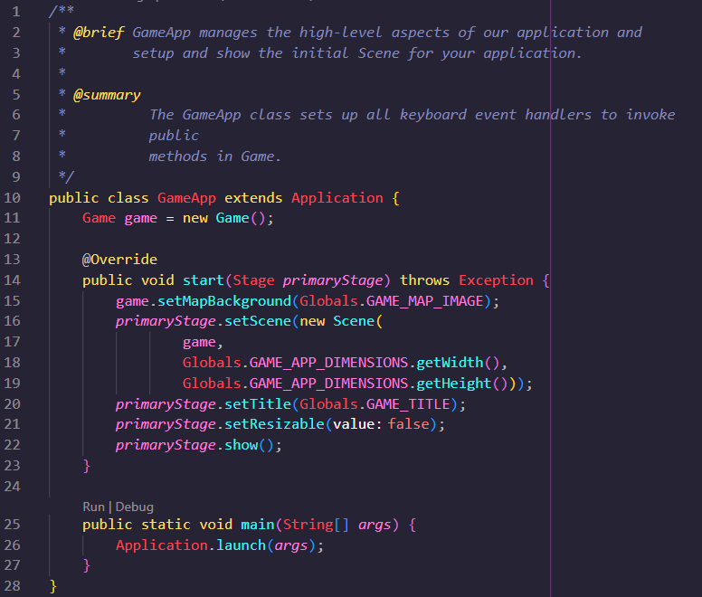
Document 0*: CSC 133 Object-Oriented Computer Graphics Programming – Rainmaker Project
* Computer science students and programmers like to count from zero: interpret as numerical one

Slide 10
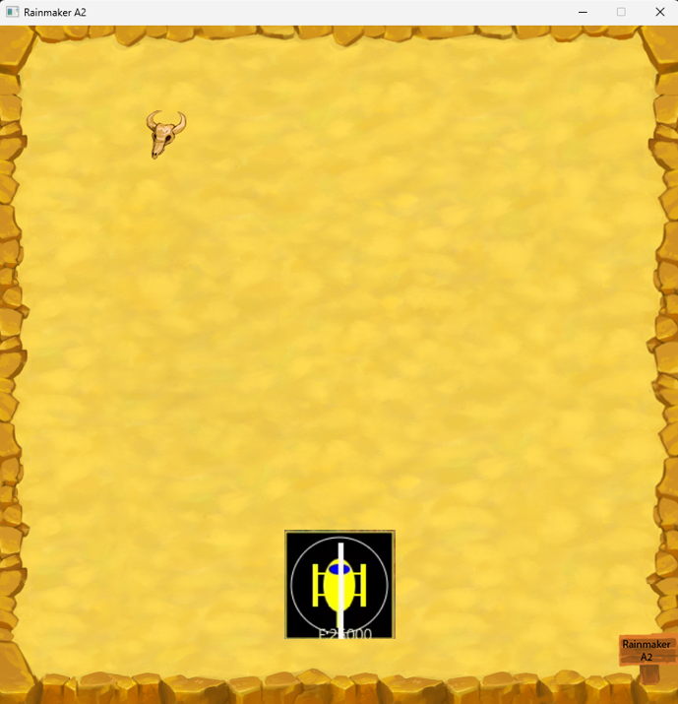
Document 0: CSC 133 Object-Oriented Computer Graphics Programming – Rainmaker Project CONT’D
This is a semester long project assigned in CSC 133 where students are introduced to 2D computer graphics and advanced topics in object-oriented programming.

Slide 11
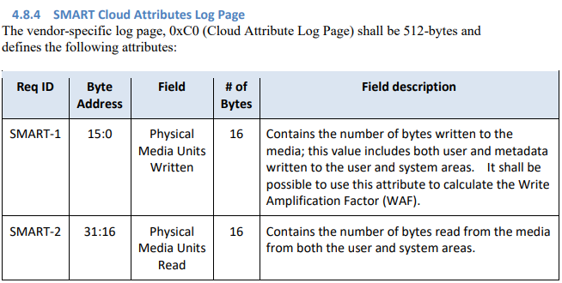
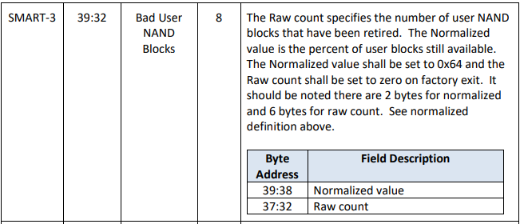
Document 1: NVMe Cloud SSD Specification - Open Compute Project
These are technical specification targeted for SSDs (solid-state drives) and is an example of technical writing within a subdomain of computer science/engineering.
Companies that want to make develop and manufacture storage devices for companies like Facebook and Microsoft must comply to these standards, specifications, and have the features prescribed in the documentation.
It is up to each company to interpret and implement these specifications. Companies that can provide equal or better performance for less cost or can justify their pricing are favored over other OEMs that produce OCP compliant SSDs.
It is the software engineer job to produce reliable and performant code, so that the hardware can run as efficiently as possible.
Source: https://www.opencompute.org/documents/nvme-cloud-ssd-specification-v1-0-3-pdf

Slide 12
SHARED BELIEFS AND ATTITUDES
Most software development are done in collaboration, so show that you’ve made an attempt/made genuine effort before asking for help, and share your learnings so others may learn from you too
Although we write code targeted for computer’s compilation or interpretation it does not mean we shouldn’t write code in a manner where it reads as good pros. Our code should be easily read by other engineers.
It’s okay to make mistakes. Learn to communicate soon and often; for, nobody knows everything. It’s okay to admit not to know something early on than to be under pressure close to a deadline and still not know.
Our industry encourages constant learning, regardless if the domain covers technical or non-technical topics, it’s all to your benefit to invest into yourself and seek ways to apply your knowledge to solve problems.

Slide 13
SHARED GENRES
Typical writing genres in computer science are, in various programming languages, often the code we write, and the external (user guides/specifications) and internal technical documentation.
Technical writing are often in form via domain specific specification, standardization, or the needs of the customer by way of “User Stories”

Slide 14
Shared Languages
Stepwise refinement (AKA Divide and conquer): the idea that software is developed by moving through the levels of abstraction, beginning at higher levels and, incrementally refining the software through each level of abstraction, providing more detail at each increment.
Object-oriented programming: a programming paradigm based on the concept of "objects", which can contain data and code: data in the form of fields, and code, in the form of procedures.
Unified Modeling Language (UML): The Unified Modeling Language is a general-purpose, developmental modeling language in the field of software engineering that is intended to provide a standard way to visualize the design of a system.
Agile: is an iterative approach to project management and software development that helps teams deliver value to their customers faster and with fewer headaches. Instead of betting everything on a "big bang" launch, an agile team delivers work in small, but consumable, increments.
Sprints: a short, time-boxed period when a scrum team works to complete a set amount of work.
User story: In software development and product management, a user story is an informal, natural language description of features of a software system.

Slide 15
Conclusion

Slide 16
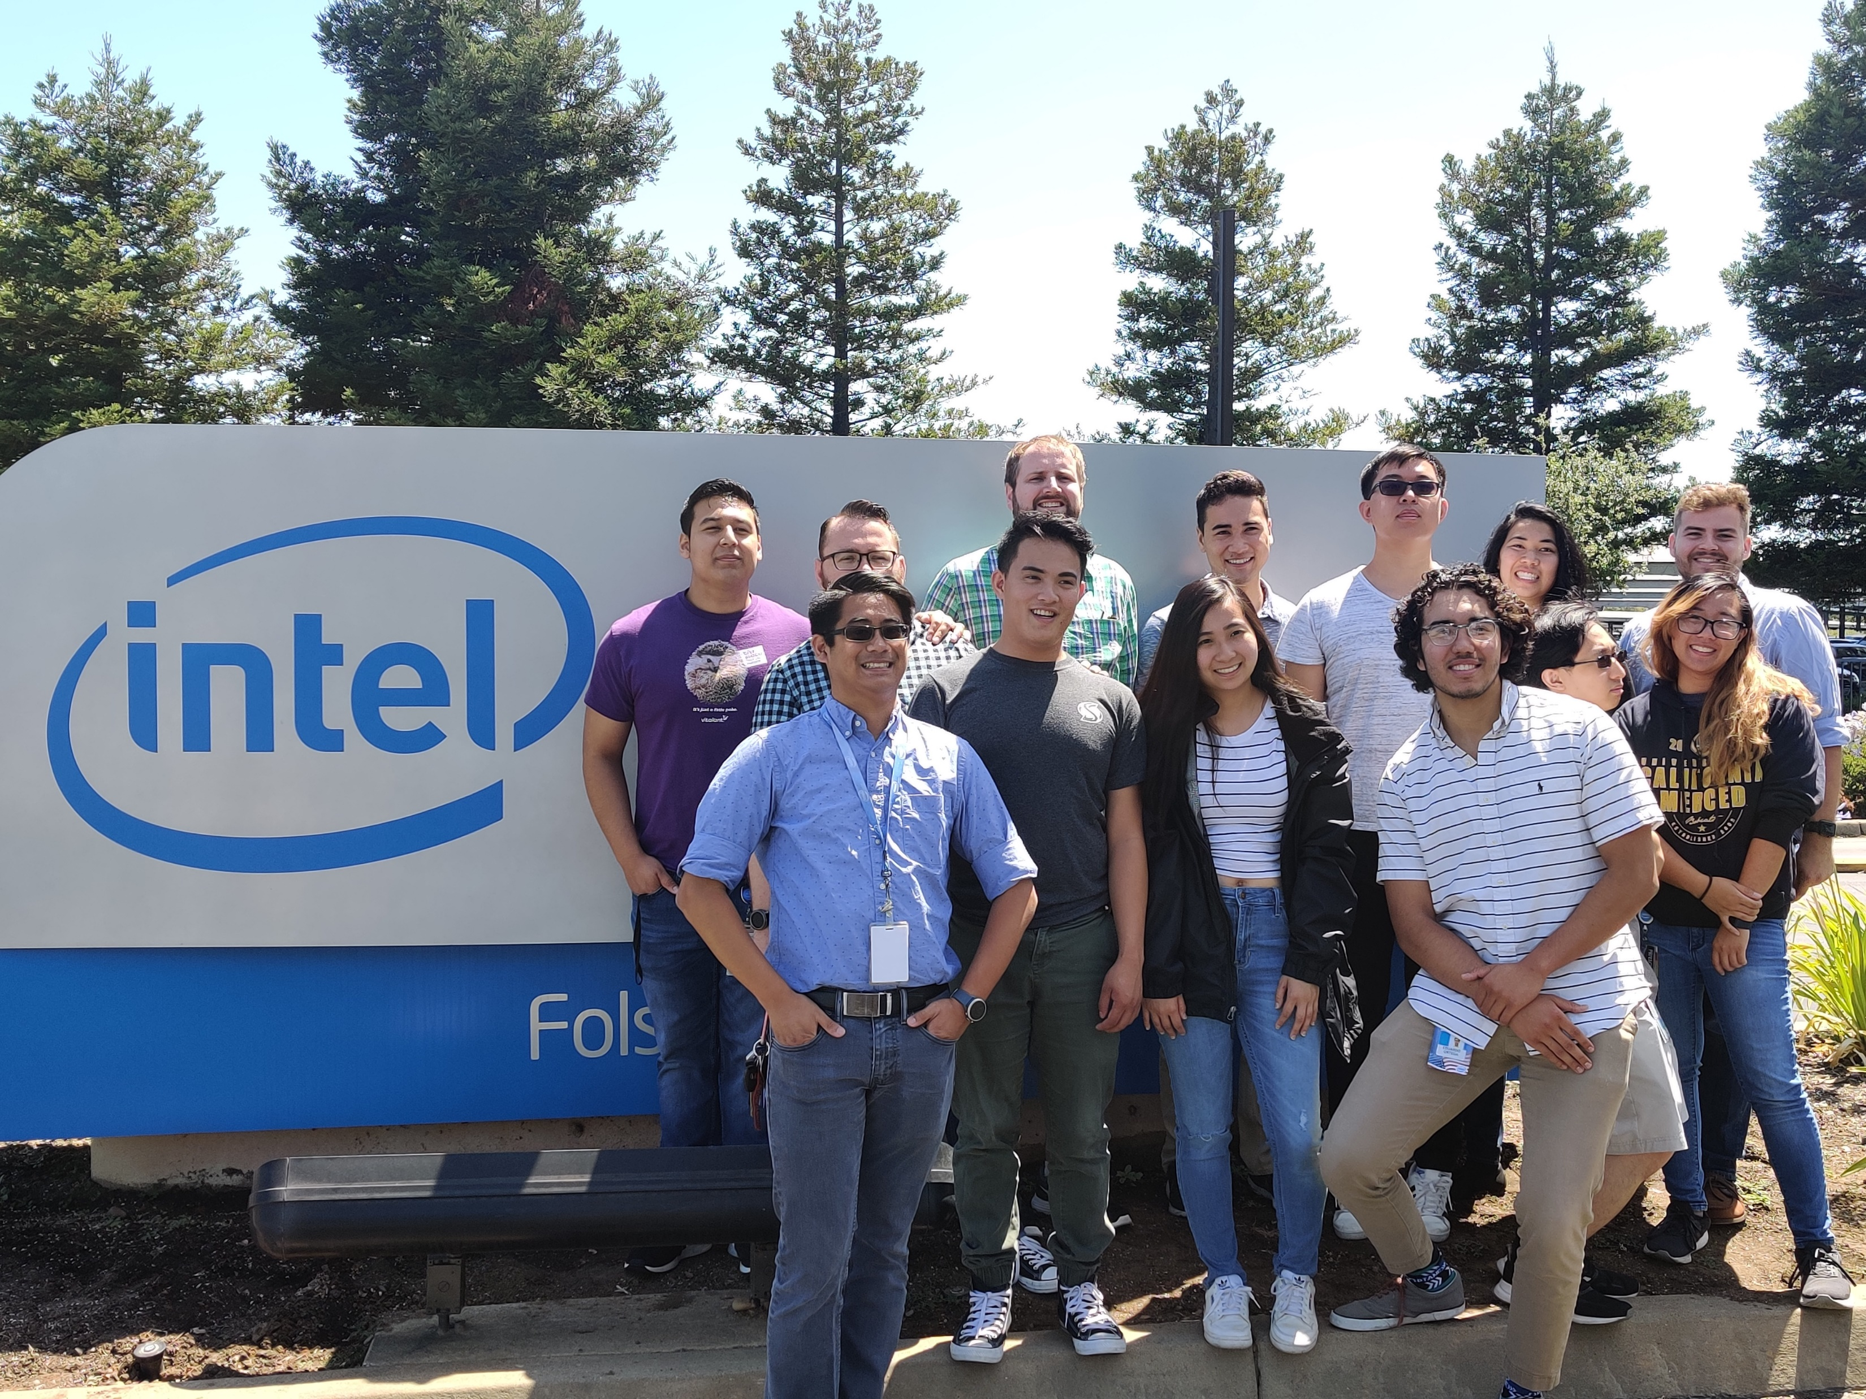
Conclusion
The general public have a lot of misconceptions of what “computer science” as programmers we provide solutions to problems with code
Having multiple internships at Intel in both marketing and technical roles have shown me regardless of your academic background if you’re willing to learn, and can demonstrate it, the divide that splits between marketing and engineering isn’t that big of a gap
Given my past internship positions, self reflection, and this project I now know, and confident, that I want to work in manufacturing

